Slide 1
UK plans for a new nuclear build A British Pugwash view
Presentation to the European Physical Society Energy Group meeting in Lisbon on 13 November 2014 by
Dr Christopher Watson

Slide 2
Current UK Energy Supply & Demand
Total energy in 2013 (annual figures from DECC DUKES Annex H)
Source | UK Production plus net imports | UK End use
Coal | 62 Mt (53 GWav) flowchart H1 | 50 Mt to power stations, producing ~15 GWav of electricity, 12 Mt (10 GWav) for home heating & industry
Oil & NGL | 96 Mtoe (128 GWav) flowchart H2 | 96 Mtoe for transport etc
Natural gas | 848 TWh (97 GWav) flowchart H3 | 202 TWh to power stations producing ~11 GW of electricity, & 646 TWh (74 GWav) for home heating & industry
Nuclear | 180 TWh (20.5 GWav) as steam in | 70.6 TWh electricity(8GWav)
Renewables | 11.7 Mtoe (15.5 GWav) flowchart H5 | producing 6 GWav of electricity &4 GWav heat
Total | 314 GWav | ~40 GW of electricity + 216 GWav of heat

Slide 3
DECC Chart H.5: Renewables flow chart 2013 (thousand tonnes of oil equivalent)
Total energy in: 11.7 Mtoe (15.5 GWav) Electrical out 6 GWav, Heat & work 4 GWav)

Slide 4
British Government Energy Policy 2014
Increasing use of low-carbon technologies
Commitment to reaching a 80% reduction in greenhouse gas emissions by 2050, and 15% of renewable energy by 2020
Keeping all compatible options open, and letting the market decide on the energy mix
Creating a level playing field by Electricity Market reform, using Feed-in Tariffs with Contracts for Difference to create competition
Supporting energy efficiency measures in the home and in industry
Supporting R&D in Carbon Capture & Storage technology
Supporting the development of commercially promising renewable options
Facilitating private sector investment in new nuclear build, by simplifying the regulatory framework, encouraging competition between vendors, and working with vendors & operators to create a globally competitive supply chain and an appropriately skilled UK workforce
Ensuring that the UK has security of energy supply and acceptable prices
Respecting public concerns about the environmental impact of energy options
Collaborating with other European and international countries on energy policy issues, while encouraging a diversity of approaches to meet specific national priorities

Slide 5
The existing UK nuclear fleet
Table 3.1 Operating nuclear generation plant in the UK
Plant | Type | Power MWe | Commissioned | Likely closure date [2]
Wylfa 1 | Magnox | 490 | 1971 | December 2015
Dungeness B 1&2 | AGR | 2 x 545 | 1983 & 1985 | 2028
Hartlepool 1&2 | AGR | 2 x 595 | 1983 & 1984 | 2024
Heysham I-1 & I-2 | AGR | 2 x 580 | 1983 & 1984 | 2019
Heysham II-1 & II-2 | AGR | 2 x 615 | 1988 | 2023
Hinkley Point B 1&2 | AGR | 2 x 430 [1] | 1976 | 2023
Hunterston B 1&2 | AGR | 2 x 430 [1] | 1976 & 1977 | 2023
Torness 1&2 | AGR | 2 x 625 | 1988 & 1989 | 2023
Sizewell B | PWR | 1188 | 1995 | 2035
Total: 16 units |  | 10,038
Source: World Nuclear Association
Notes:
[1] Designed as 2 x 610 MWe but currently running at 70%
[2] Latest information on WNA website
AGR dates given here assume exactly seven years and may be over- or under-estimates. None of the above dates is immutable, but the cost of further life extensions would be significant.
^{[1]} http://

Slide 6
Power reactors planned and proposed
Proponent | Site |  | Locality | Type | Capacity (MWe gross) |  | Planned Start-up
EDF Energy | Hinkley Point C-1 |  | Somerset | EPR | 1670 |  | 2023
 | Hinkley Point C-2 |  |  | EPR | 1670 |  | 2024
EDF Energy | Sizewell C-1 |  | Suffolk | EPR | 1670 |  | ?
 | Sizewell C-2 |  |  | EPR | 1670 |  | ?
Horizon | Wylfa Newydd 1 |  | Wales | ABWR | 1380 |  | 2025
Horizon | Wylfa Newydd 2 |  | Wales | ABWR | 1380 |  | 2025
Horizon | Oldbury B-1 |  | Gloucestershire | ABWR | 1380 |  | late 2020s
Horizon | Oldbury B-2 |  | Gloucestershire | ABWR | 1380 |  | late 2020s
NuGeneration | Moorside 1 |  | Cumbria | AP1000 | 1135 |  | 2024
NuGeneration | Moorside 2 |  |  | AP1000 | 1135 |  | ?
NuGeneration | Moorside 3 |  |  | AP1000 | 1135 |  | ?
Total planned & proposed | 11 units |  |  |  | 15,600 MWe
GE Hitachi | Sellafield | Cumbria |  | 2 x PRISM | 2 x 311
Candu Energy | Sellafield | Cumbria |  | 2 x Candu EC6 | 2 x 740

Slide 7
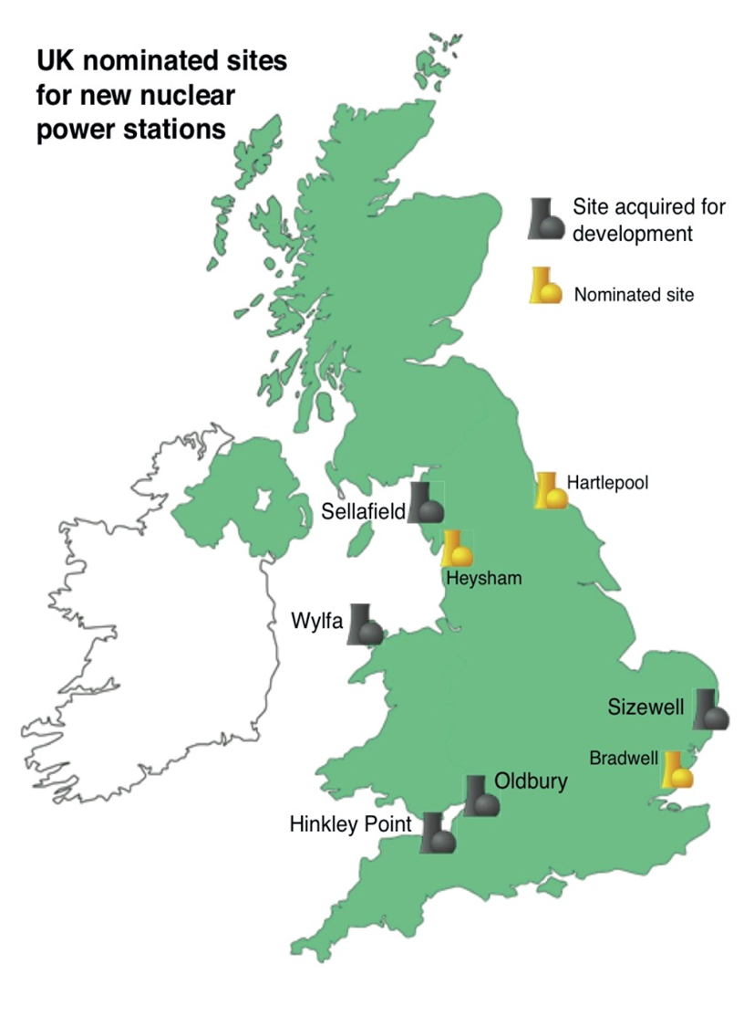

Slide 8
The Utilities/Consortia currently in play I
EDF Energy
This consortium was formed in January 2009 when EDF (a firm 85% owned by the French government) bid successfully for British Energy. Later that year Centrica, an international energy firm which owns British Gas, bought a 20% stake in British Energy. More recently two Chinese companies, CGN and CNNC have bought into the consortium, and Areva has taken a share. The consortium owns land at Hinkley Point and Sizewell and is currently planning to build four EPR reactors, two at Hinkley Point C and two at Sizewell C. In October 2013 it agreed the terms of a £16B deal on Hinkley Point C, involving a 35 year Contract for Difference, with a Strike Price of £89.5/MWh, subject to a positive decision by the EC that the deal did not violate EU state aid rules. This decision was confirmed in October 2014, and construction work has started.
Horizon
This consortium was formed by the German companies RWE npower and E.ON UK early in 2009, and it bid successfully for land at Oldbury, Wylfa and Bradwell. Its initial plans involved building a mixture of AP1000 and EPR reactors. Early in 2012, RWE and E.ON decided to withdraw, and eventually Hitachi made a successful bid for its assets, and decided to construct two or three ABWR reactors at each site. In May 2013 it signed an engineering & design contract with Hitachi-GE Nuclear Engineering for work on the Wylfa Newydd Generic Design Assessment, due to be completed in 2017.

Slide 9
The Utilities/Consortia currently in play II
NuGeneration
This consortium was set up early in 2009, initially as a joint venture between Iberdrola (which owns Scottish Power) and GDF Suez (a French firm with roots going back to the construction of the Suez canal). In December 2013 Iberdrola sold its share to Toshiba, which also bought 20% of the GDF Suez shareholding so as to give it control. In October 2009, the consortium bought a site called Moorside on the northern edge of Sellafield. It now plans to construct three AP1000 reactors there. The investment decision is expected in 2018. The site will need substantial extensions of the National Grid to both north & south, and there are connection agreements (for 2023 and 2025)
Pu disposition reactor at Sellafield
Although not yet a well-established project, discussions with the NDA are in progress on two alternative reactor concepts for the task of utilising the energy content of the UK stockpile of 100 tonnes of Pu. The proposals are:
GE Hitachi : 2x PRISM reactors of 311 MW each
Candu Energy: 2x Candu EC6 reactors of 740 MW each
The NDA plans to continue their evaluation of these options over the next two years

Slide 10
Three possible pathways to 2050 A British Pugwash paper published in 2013
In October 2011, British Pugwash set up a Working Group to define some possible strategies for meeting British energy requirements up to 2050. These were to be constrained by three requirements:
All the technologies involved should either exist now, or have a good chance of being developed on the industrial scale required to meet the energy demand in 2050
By 2050, the overall system should meet the UK government to reduce emissions by 80%
Capital and operating costs for the proposed system should be competitive with alternatives, when costed using the DECC public domain ‘Pathways to 2050’ software package
We appointed three ‘champions’ to develop three alternative systems:
‘High nuclear’, in which nuclear power was to be used to the maximum practicable extent
‘High renewables’, in which nuclear power is replaced by renewables as quickly as practicable
‘Intermediate’, in which nuclear and renewable elements are supplemented by fossil + CCS
All three champions designed a system which arguably met the three requirements. They all achieved the required reduction in emissions, and the overall cost of each system from 2010-2050 was essentially identical to that of the other two. Each system used technologies which could be claimed to exist or to have good prospects of being developed in time. However:

Slide 11
Three possible pathways to 2050
In each case, a critic could point to a possible ‘show-stopper’ – a feature of one of the component technologies which would prove to be unworkable, thereby undermining the credibility of the whole system.
The ‘high nuclear’ option depended on the chosen ‘third-generation’ reactor systems having the required safety, security, reliability and capital cost. None of the existing prototypes have yet demonstrated this.
The ‘high renewables’ option had to address some public acceptability issues, and it also has to cope with the intermittency of all renewables, and none of the proposed solutions to this problem were wholly satisfactory. In particular, the suggestion that the system should generate a lot more energy than the UK needed, and should sell the surplus overseas, seemed economically questionable. Other solutions involved large-scale energy storage systems with an uncertain cost.
The ‘intermediate’ option depends on Carbon Capture & Storage systems on a scale which has not yet been attempted. Some features – such as the pipework required to transport vey large volumes of CO2 from source to sink- seemed difficult to implement at an acceptable cost and on the required timescale
The judgement of the Working Party was that the UK should pursue all three pathways in parallel until it was clear that one pathway was free of all such show-stoppers

Slide 12
Parameters of the three pathways High Nuclear (HN), High Renewables (HR) and Intermediate (Int)
Table 7.1.3 Comparison of proposed energy mix with actual figures in 2010
2010 2030 2050
Electric Capacity (GWn) Actual HN HR Int HN HR Int
Nuclear 11 28 1 16 80 0 39
Renewable 9 27 99 40 18 181 40
Fossil/CCS 71 37 12 42 21 2 51
Total electric capacity 91 120 112 126 119 183 130
Electricity supplied (GWav)44 57 46 56 86 76 79
Total energy supply(GWav)211 257 170 238 337 164 269
Energy demand reduction by 2050 20% 40% 20%
Greenhouse gas emissions 81% 43% 31% 44% 19% 18% 20% of 1990 value
Biocrop land use 1% 2% 5% 2% 5% 10% 5% of total land area
Total cost 2010-2050 (Point estimate in £Trillion) 2.67 2.52 2.59

Slide 13
A comparison of the three Pathways
All three Pathways achieve some reduction in end-user demand by 2050 (HN and Int ~20%, HR ~40%). However larger reductions than this would be controversial.
All three approximately double the electrical energy supplied, because they depend on end-use electrification to reduce emissions, but the HR electrical capacity is much higher, to give a reserve to cope with renewables intermittency
Two of the three Pathways expand the Nuclear fleet significantly beyond the immediate ‘new build’ scale (HN 80 GWe, Int 39 GWe). The third eliminates it altogether.
All three Pathways include some renewable energy capacity, but the amounts vary greatly (HN 18 GW, Int 40 GW, HR 181 GW)
All three include some CCS (HR 2 GW, HN 21 GW, Int 51 GW)
All three achieve the 80% reduction in emissions by 2050, but the HR Pathway achieves reductions earlier, because it has no nuclear build
All three Pathways are estimated to cost £3 trillion over the period 2010-2050. Cost differences between them are less than the uncertainties.
All three pathways have potential ‘show-stoppers’, and they need to be pursued in parallel, with substantial government support, until the best option has been established
All three pathways require urgent action very soon if the 2050 target is to be met. It is unrealistic to expect the private sector to move so quickly without public sector support. The EU could play a valuable role here.

Slide 14
The political dimension
Public outcry at actual or imminent power cuts or brownouts
The UK is foreseen to be within 4% of a brownout this winter, and the Minister has felt obliged to give career-threatening assurances
Unforeseen power station outages have a tendency to occur when it is cold, and can have life-threatening consequences. The recent fire at Didcot power station was a warning.
All the proposed pathways depend on rapid construction of partially unproven technology, and its devotees tend to be over-optimistic on timescales
All the proposed pathways only just meet the 80% emissions target in 2050
That is a purely political target, and climate modellers disagree over its adequacy
Politicians tend to give assurances on the affordability of energy without having regard to their achievability. There have recently been major public protests in the UK, Germany and the EU at retail prices rises, unemployment and economic disruption, all attributed to bad energy policies
All European countries are having to make major energy infrastructure investments at a time of financial crisis, coinciding with a climate threat.
All this requires skilful decision-making, with the right mixture of public-sector and private-sector management, and good communications with the public

Slide 15
Chart H.1: Coal flow chart 2013 (million tonnes of coal)

Slide 16
Chart H.2: Petroleum flow chart 2013 (million tonnes)

Slide 17
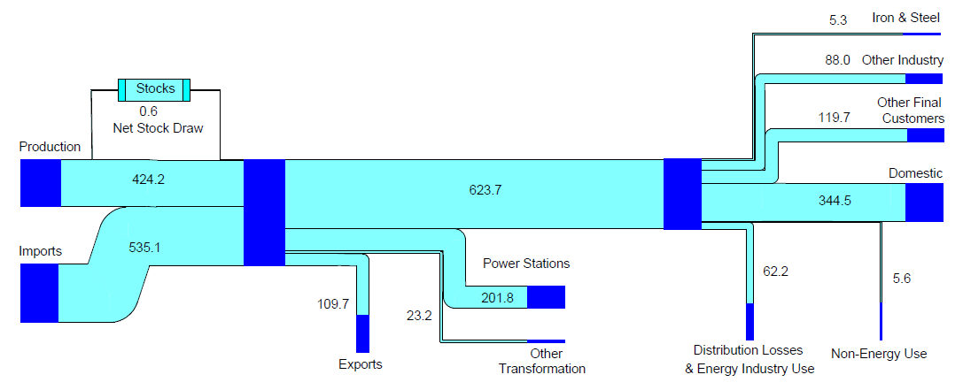
Chart H.3: Natural gas flow chart 2013 (TWh)

Slide 18
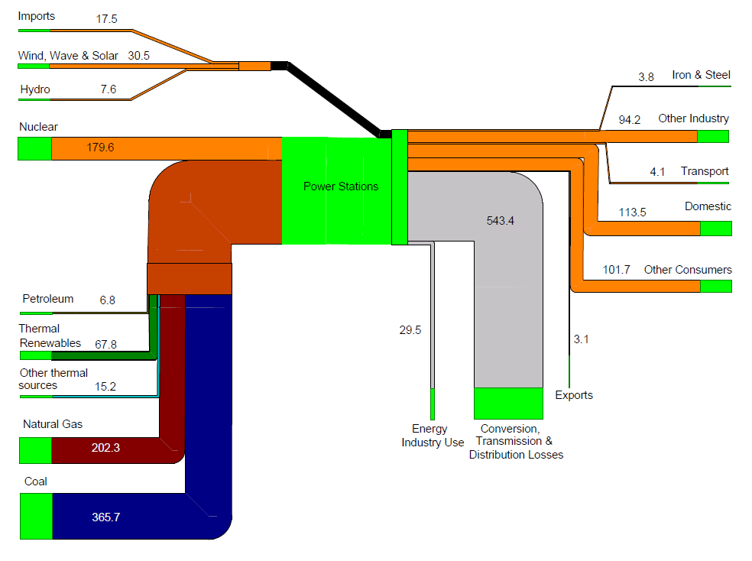
Chart H.4: Electricity flow chart 2013 (TWh)

Slide 19
Chart H.5: Renewables flow chart 2013 (thousand tonnes of oil equivalent)

